Slide 1

Essentials of Economics
Seventh Edition
Chapter 3
Where Prices Come From: The Interaction of Demand and Supply
Copyright © 2021, 2019, 2017 Pearson Education, Inc. All Rights Reserved.
Notes:
If this PowerPoint presentation contains mathematical equations, you may need to check that your computer has the following installed:
1) MathType Plugin
2) Math Player (free versions available)
3) NVDA Reader (free versions available)

Slide 2
Chapter Outline
3.1 The Demand Side of the Market
3.2 The Supply Side of the Market
3.3 Market Equilibrium: Putting Demand and Supply Together
3.4 The Effect of Demand and Supply Shifts on Equilibrium

Slide 3
Our Model of a Market
To analyze the market we need a model of how buyers and sellers behave.
The model we use in this chapter is a perfectly competitive market, a market with:
many buyers and sellers
all firms selling identical products
no barriers to new firms entering the market.
While these assumptions are quite restrictive, the model is still useful for analyzing many markets.

Slide 4
Ceteris paribus assumption
When drawing the demand and supply curves, we assume ceteris paribus.
Ceteris paribus (“all else equal”) condition: The requirement that when analyzing the relationship between two variables—such as price and quantity demanded—other variables must be held constant.

Slide 5
3.1 The Demand Side of the Market
Demand represents the consumer side of the market.
We begin our analysis of where prices come from by investigating how buyers behave.
We refer to this as market demand, the demand by all the consumers of a given good or service.

Slide 6
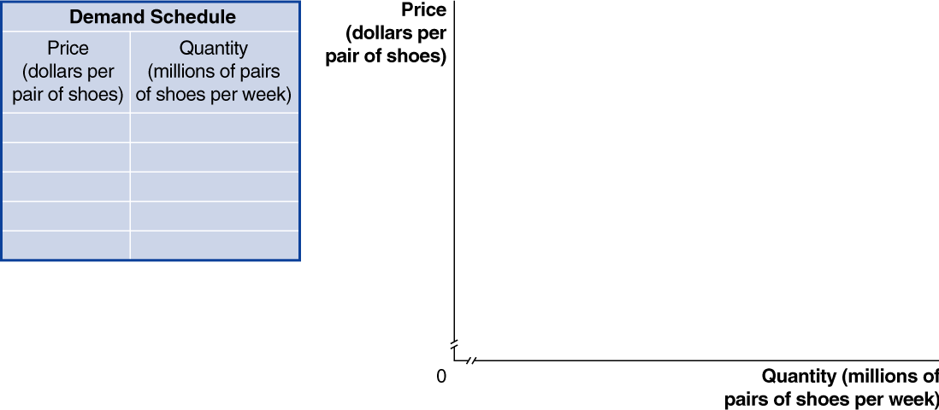
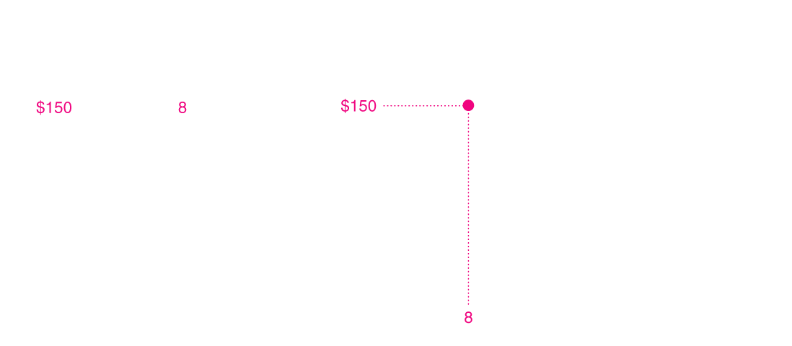
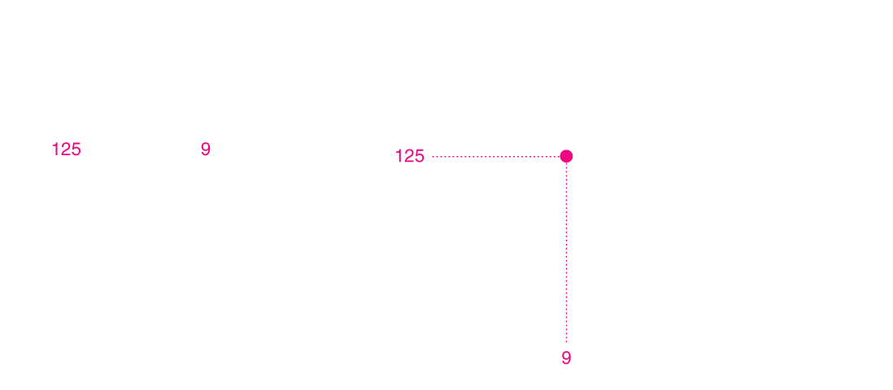
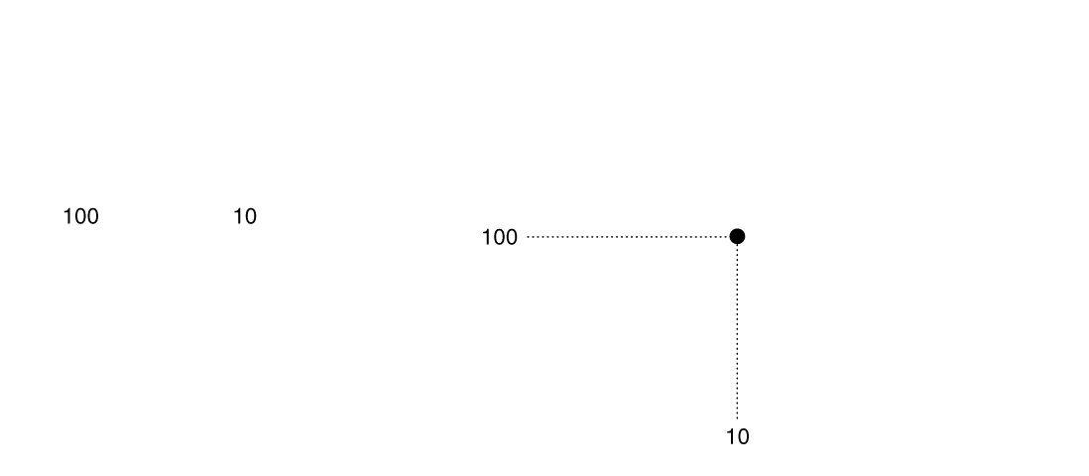
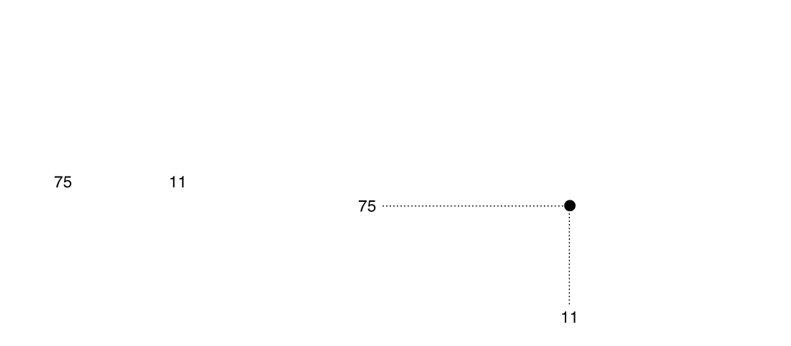
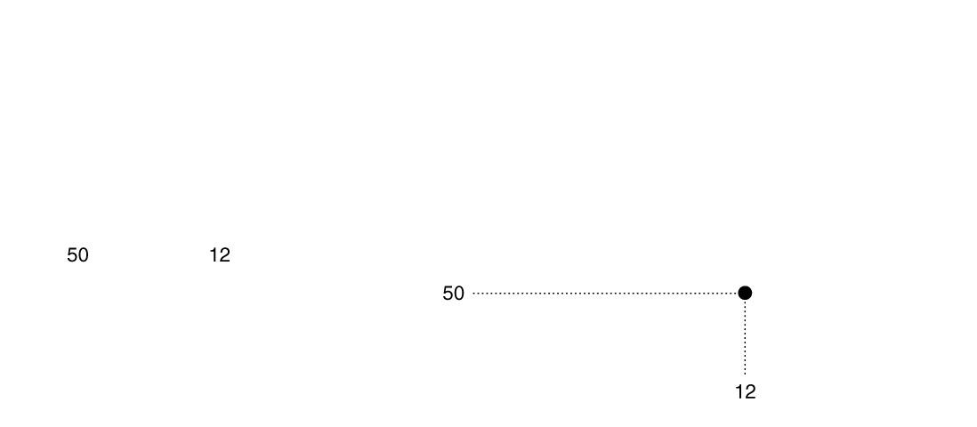
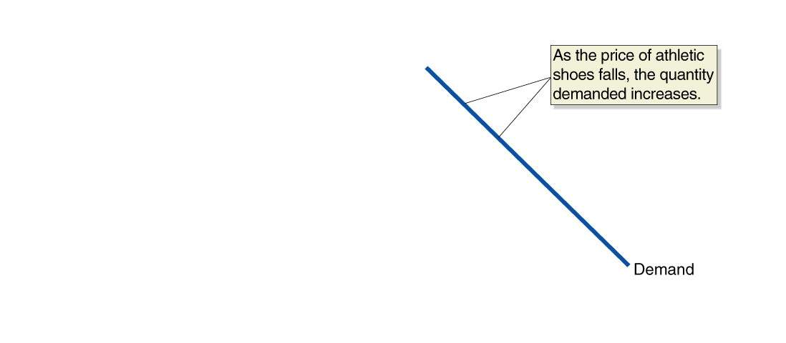
Figure 3.1 A Demand Schedule and a Demand Curve (1 of 3)
Demand schedule: A table that shows the relationship between the price of a product and the quantity of the product demanded.
Demand curve: A curve that shows the relationship between the price of a product and the quantity of the product demanded.
Quantity demanded: The amount of a good or service that a consumer can purchase at a given price.
Law of demand: A rule that states that, holding everything else constant, when the price of a product falls, the quantity demanded of the product will increase, and when the price of a product rises, the quantity demanded of the product will decrease.

Slide 7
Substitution and Income Effects
When the price of a good falls, two effects take place:
Consumers substitute toward the good whose price has fallen.
Consumers have more purchasing power, which is like an increase in income.
We call these the substitution effect and the income effect:
Substitution effect: The change in the quantity demanded of a good that results from a change in price, making the good more or less expensive relative to other goods, holding constant the effect of the price change on consumer purchasing power.
Income effect: The change in the quantity demanded of a good that results from the effect of a change in the good’s price on a consumer’s purchasing power, holding all other factors constant.

Slide 8
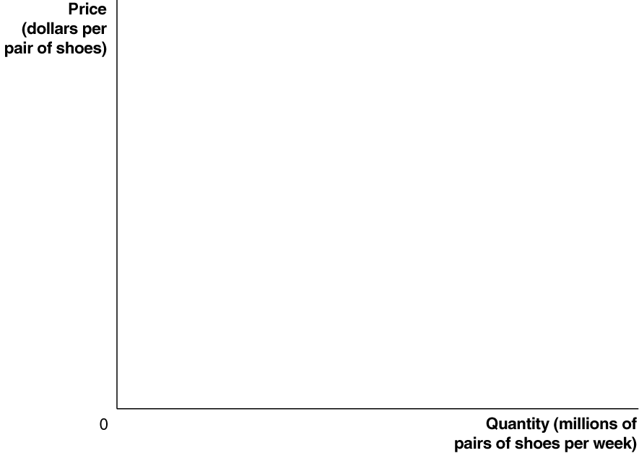
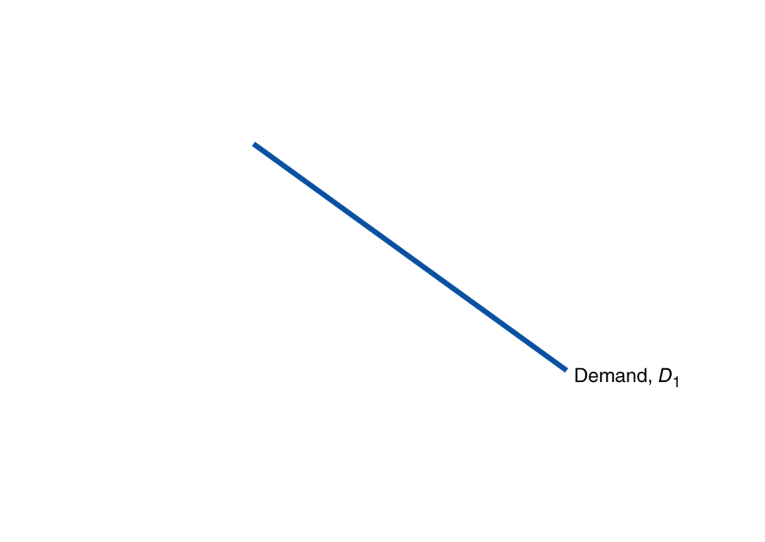
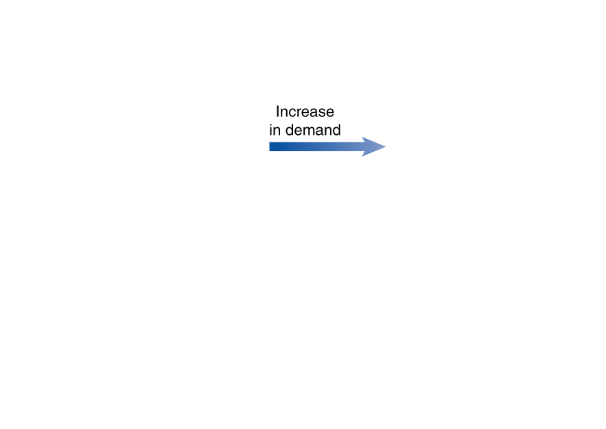
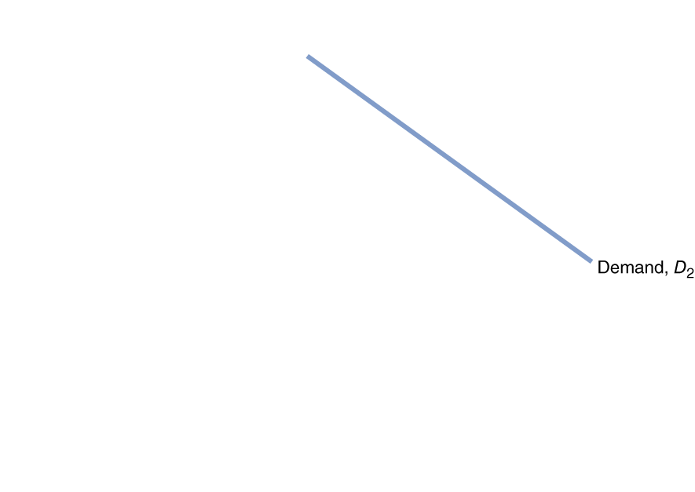
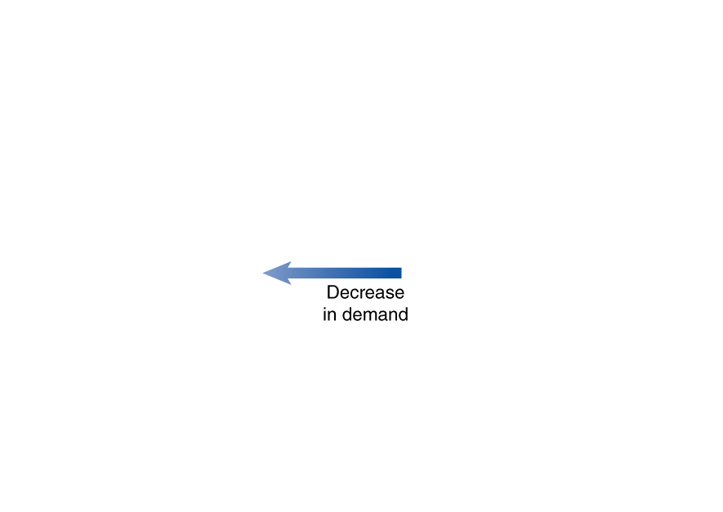
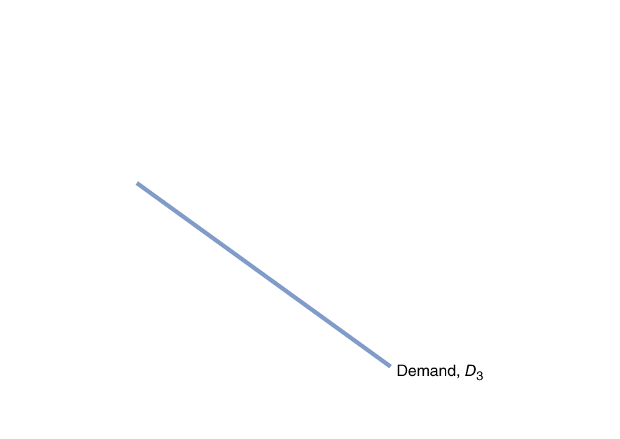
Figure 3.2 Shifting the Demand Curve
A change in something other than price that affects demand causes the entire demand curve to shift.
A shift to the right (D₁ to D₂) is an increase in demand.
A shift to the left (D₁ to D₃) is a decrease in demand.
TIP: Because demand and supply shift along the Quantity (X) axis, shifts are left and right. An increase in demand or supply shifts the curve to the right. A decrease shifts the curve to the left.

Slide 9
Variables That Shift Market Demand
Income
Increase in income increases demand if product is normal, decreases demand if product is inferior.
Prices of related goods
Increase in price of related good increases demand if products are substitutes, decreases demand if products are complements.
NOTE: This isn’t the same as a change in the price of the good, which only causes movement along the demand curve.
Tastes
Population and demographics
Expected future prices

Slide 10
Changes in Income of Consumers
Normal goods: Goods for which the demand increases as income rises and decreases as income falls.
Examples: New clothes
Restaurant meals
Vacations
Inferior goods: Goods for which the demand increases as income falls and decreases as income rises.
Examples: Second-hand clothes
Non-name brand items

Slide 11
Changes in the Price of Related Goods
Substitutes: Goods and services that can be used for the same purpose.
Examples: Big Mac and Whopper
Ford F-150 and Dodge Ram
Jeans and Khakis
Complements: Goods and services that are used together.
Examples: Big Mac and McDonald’s fries
Hot dogs and hot dog buns
Left shoes and right shoes

Slide 12
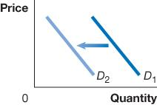
Changes in Tastes
Tastes
If consumers’ tastes change, they may buy more or less of the product.
Example: If consumers become more concerned about eating healthily, they might decrease their demand for fast food.

Slide 13
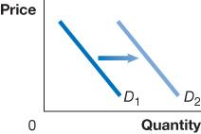
Changes in Population/Demographics
Demographics: The characteristics of a population with respect to age, race, and gender.
Increases in the number of people buying something will increase the amount demanded.
Example: An increase in the elderly population increases the demand for medical care.

Slide 14
Changes in Expectations about Future Prices
Consumers decide which products to buy, but also when to buy them.
Future products are substitutes for current products.
An expected increase in the price tomorrow increases demand today.
An expected decrease in the price tomorrow decreases demand today.
Example: If you found out the price of gasoline would go up tomorrow, you would increase your demand today.

Slide 15
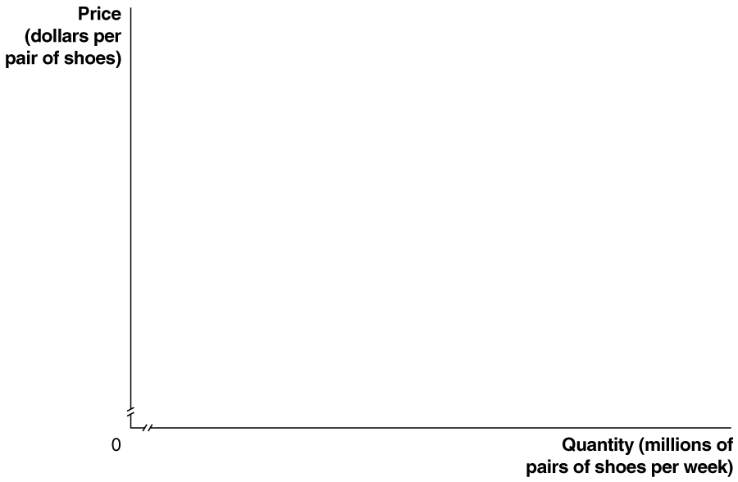
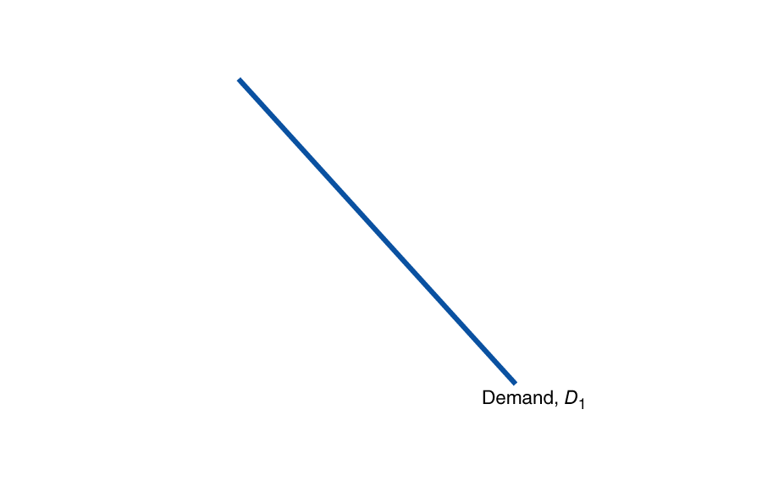
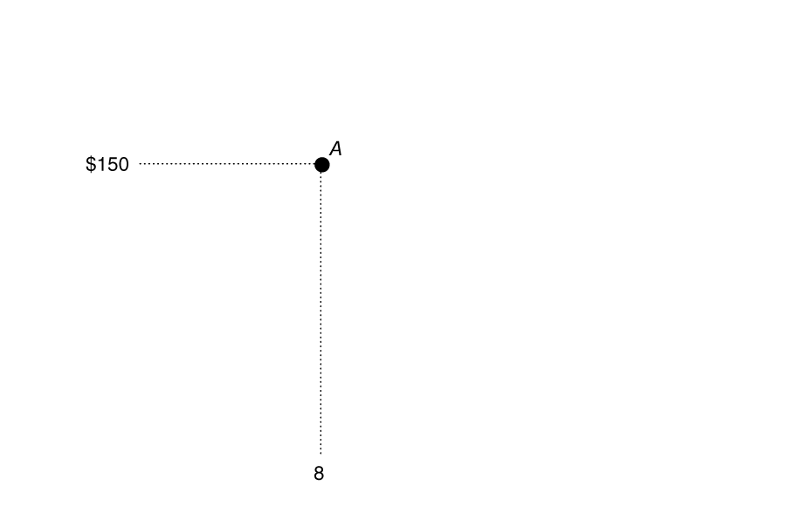
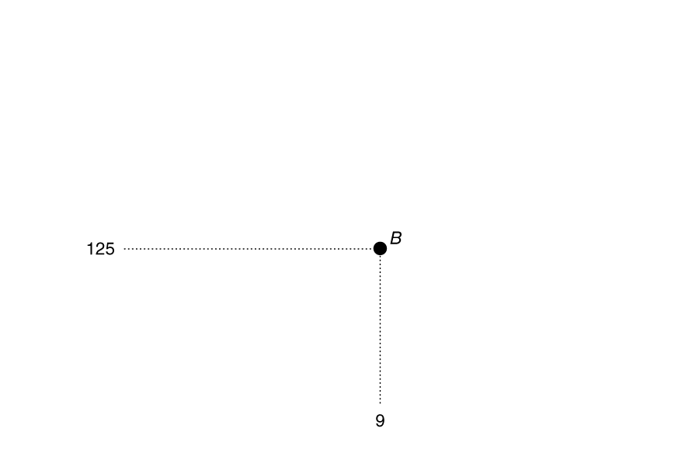
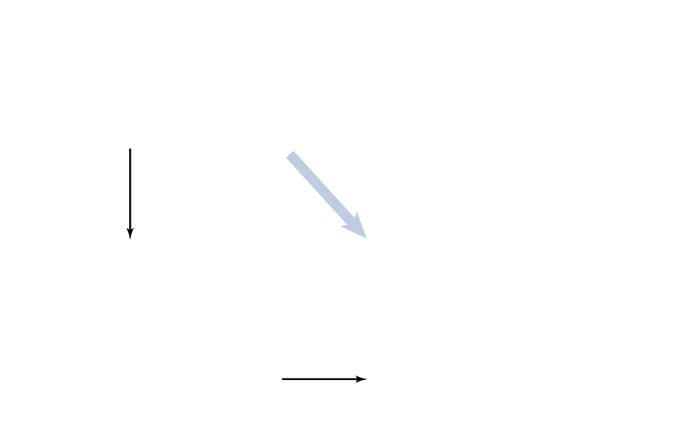
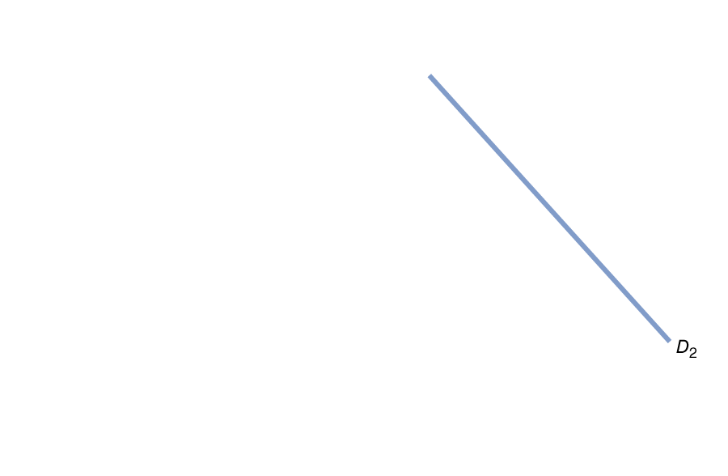
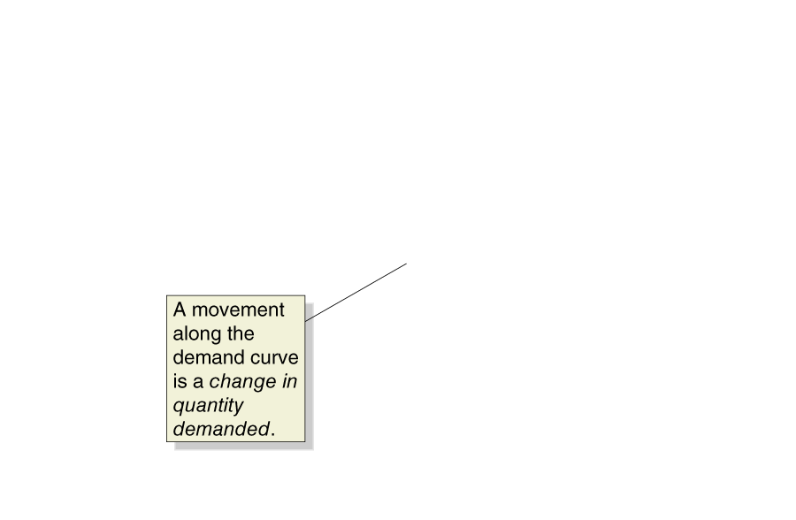
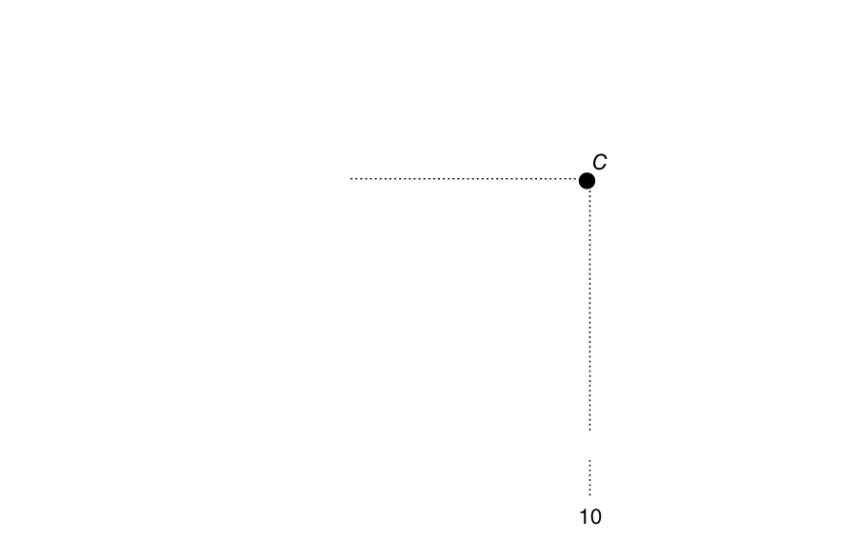
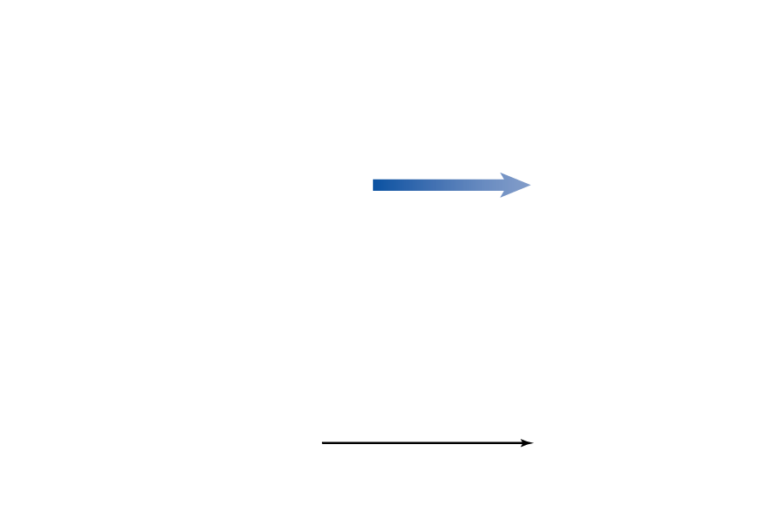
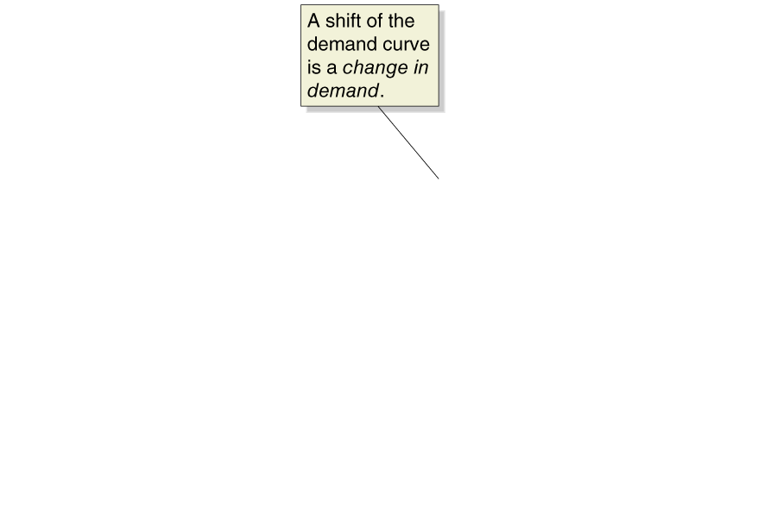
Figure 3.3 A Change in Demand vs. Change in Quantity Demanded
A change in the price of the product being examined causes a movement along the demand curve.
This is a change in quantity demanded.
Any other change affecting demand causes the entire demand curve to shift.
This is a change in demand.

Slide 16
3.2 The Supply Side of the Market
Supply represents the producer side of the market.
There are some similarities, and some important differences between the demand and supply sides of the market.
In this section we examine the market supply, i.e. the decisions of (generally) firms about how much of a product to provide at various prices.

Slide 17
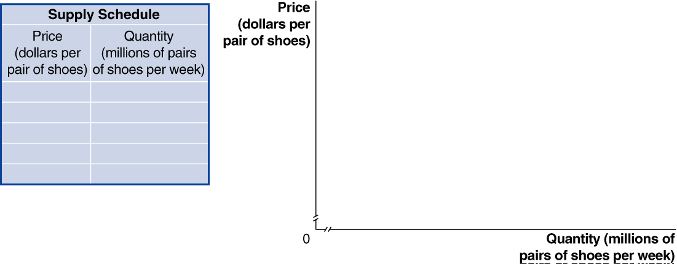

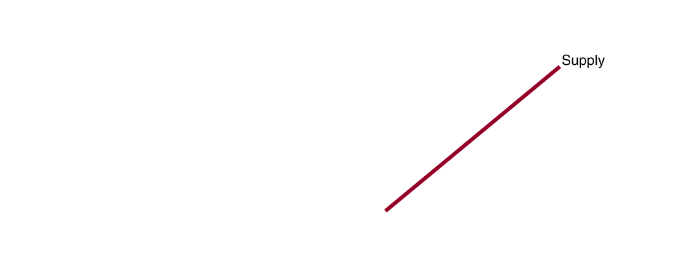
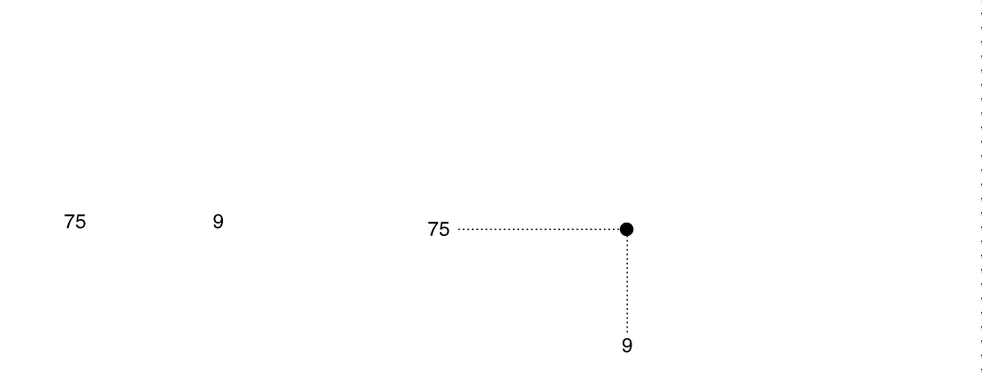
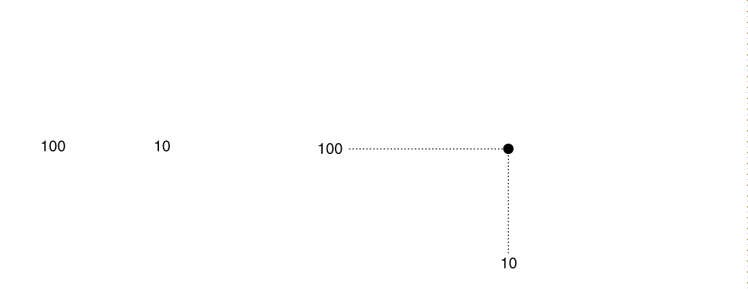
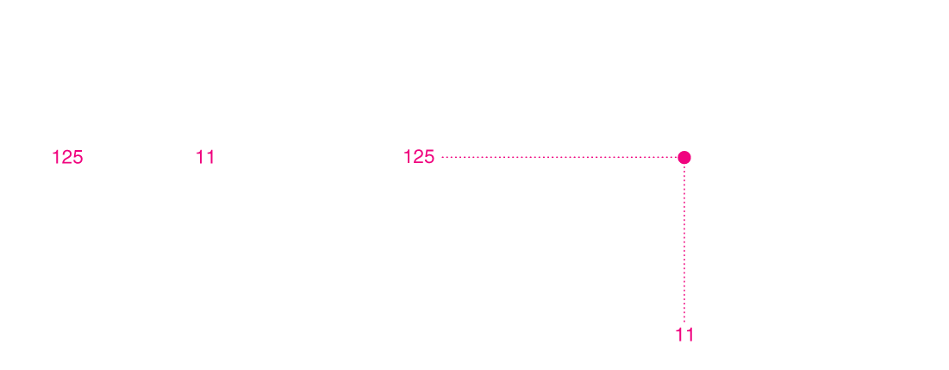
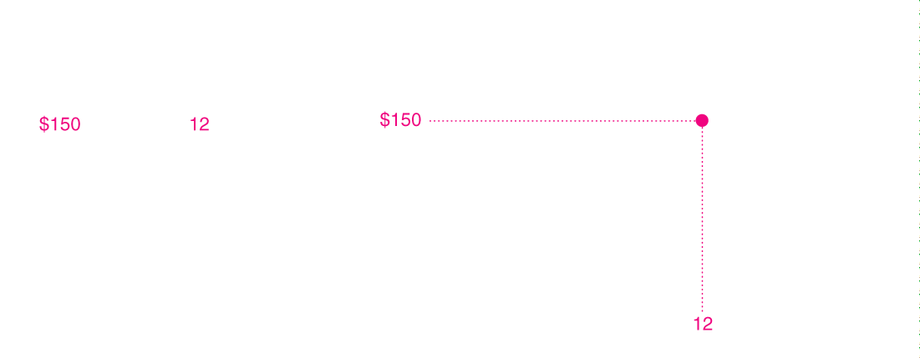
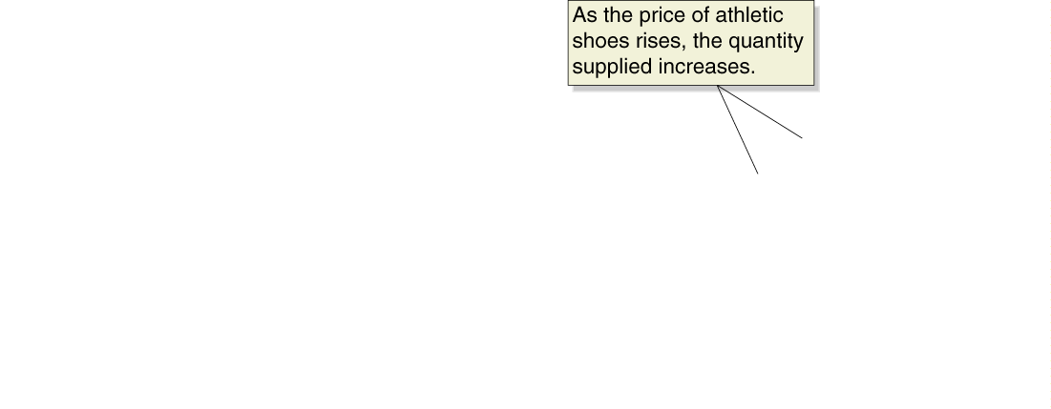
Figure 3.4 A Supply Schedule and Supply Curve (1 of 2)
Supply schedule: A table that shows the relationship between the price of a product and the quantity of the product supplied.
Supply curve: A curve that shows the relationship between the price of a product and the quantity of the product supplied.
Quantity supplied: The amount of a good or service that a firm is willing and able to supply at a given price.
Law of supply: A rule that states that, holding everything else constant, increases in price cause increases in the quantity supplied, and decreases in price cause decreases in the quantity supplied.

Slide 18
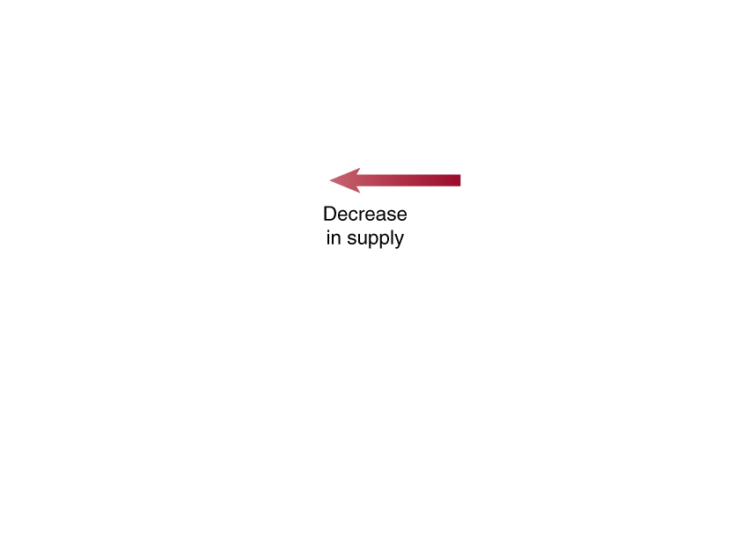
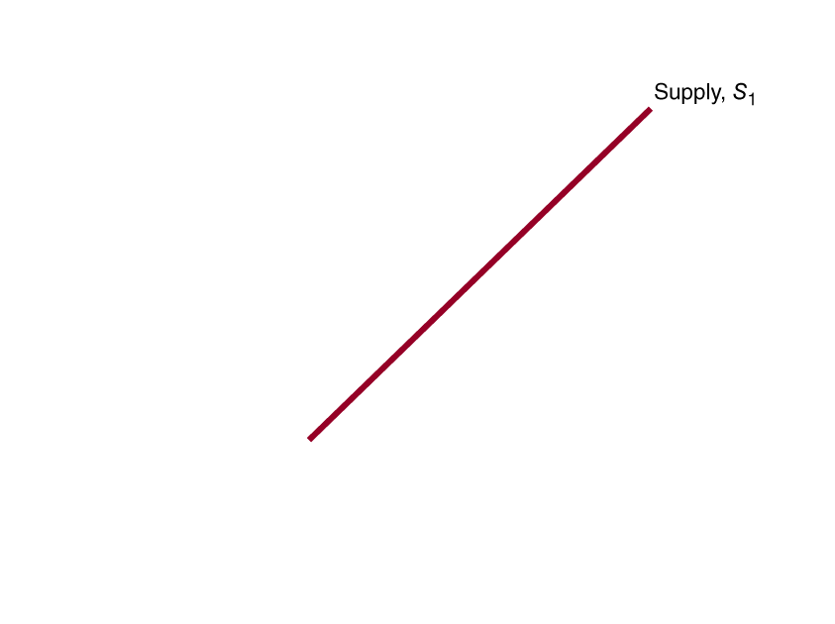
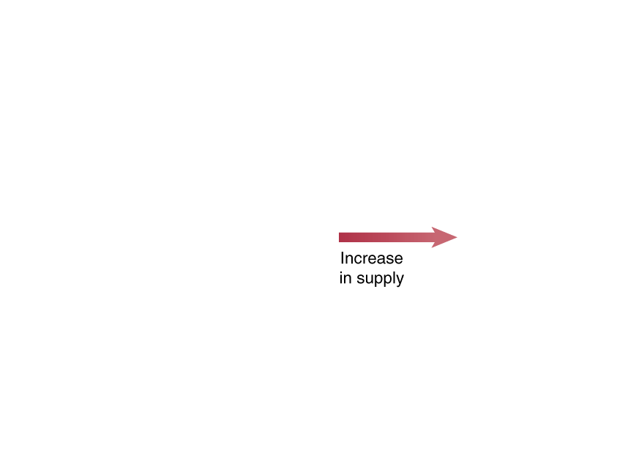
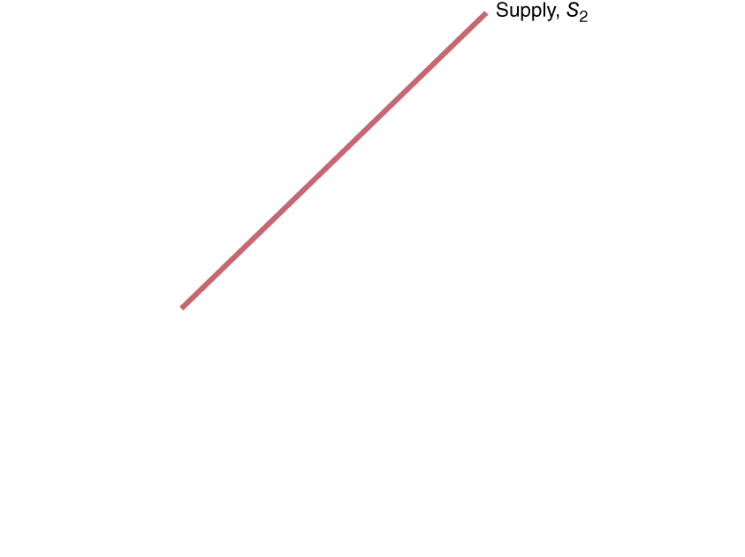
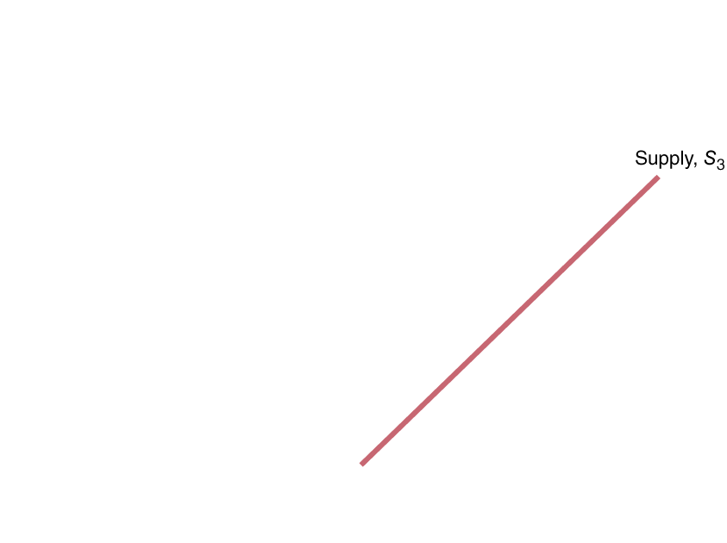
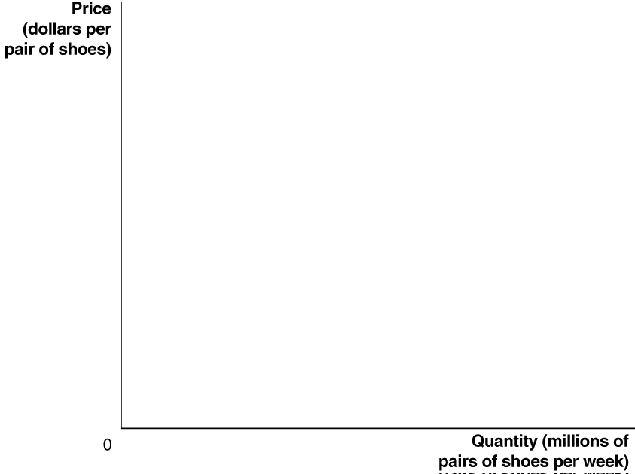
Figure 3.5 Shifting the Supply Curve (1 of 2)
A change in something other than price that affects supply causes the entire supply curve to shift.
A shift to the right (S₁ to S₃) is an increase in supply.
A shift to the left (S₁ to S₂) is a decrease in supply.

Slide 19
What Factors Influence Market Supply?
Prices of inputs
Technological change
Prices of related goods in production
Number of firms in the market
Expected future prices

Slide 20
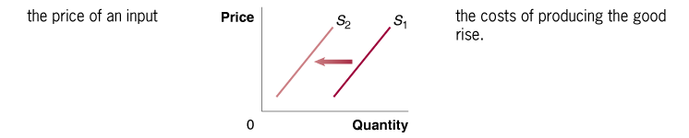

Change in Prices of Inputs
Inputs are things used in the production of a good or service.
For an athletic shoe, inputs include the rubber, plastic, and labor.
An increase in the price of an input decreases the profitability of selling the good, causing a decrease in supply.
A decrease in the price of an input increases the profitability of selling the good, causing an increase in supply.

Slide 21
Technological Change
A firm may experience a positive or negative change in its ability to produce a given level of output with a given quantity of inputs. We call this a technological change.
Examples:
A new, more efficient way of producing shoes would increase their supply.
Governmental restrictions on how much workers are allowed to work might decrease the supply of athletic shoes.

Slide 22
Prices of Related Goods in Production
Many firms can produce and sell alternative products: substitutes in production.
Example: An Illinois farmer can plant corn or soybeans. If the price of soybeans rises, he will plant (supply) less corn.
Sometimes, two products are necessarily produced together: complements in production
Example: Cattle provide both beef and leather. An increase in the price of beef encourages more cattle farming, and hence increase the supply of leather.

Slide 23
Number of Firms and Expected Future Prices
More firms in the market will result in more product available at a given price (greater supply).
Fewer firms → supply decreases.
If a firm anticipates that the price of its product will be higher in the future, it might decrease its supply today in order to increase it in the future.

Slide 24
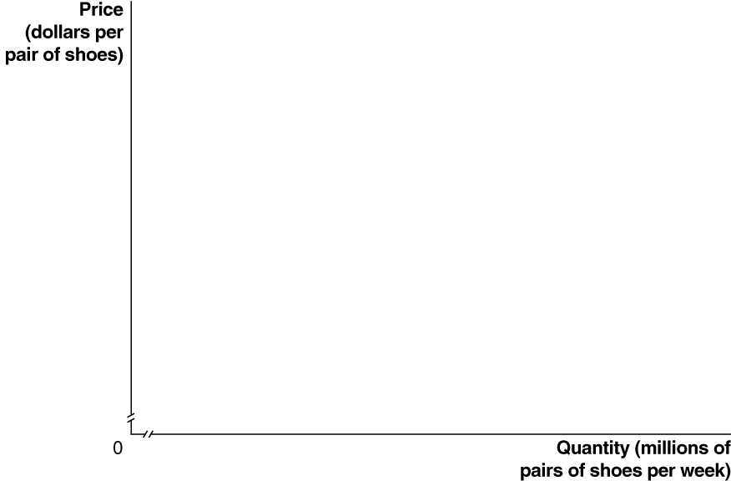
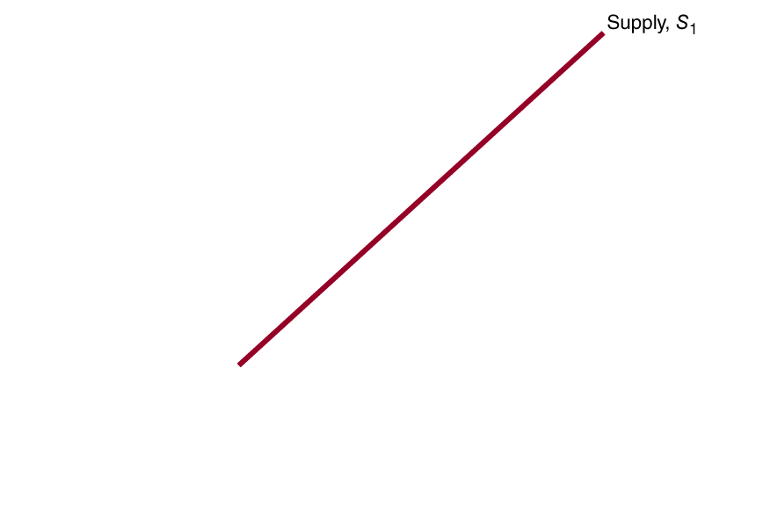
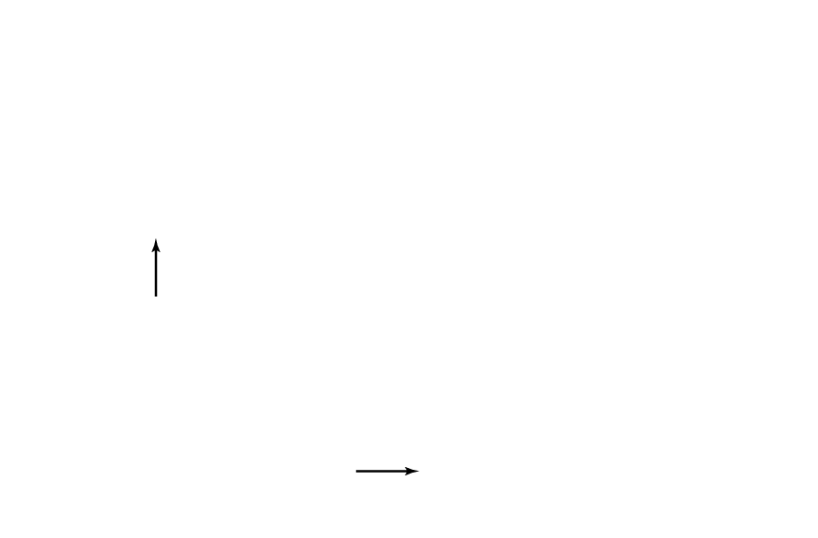
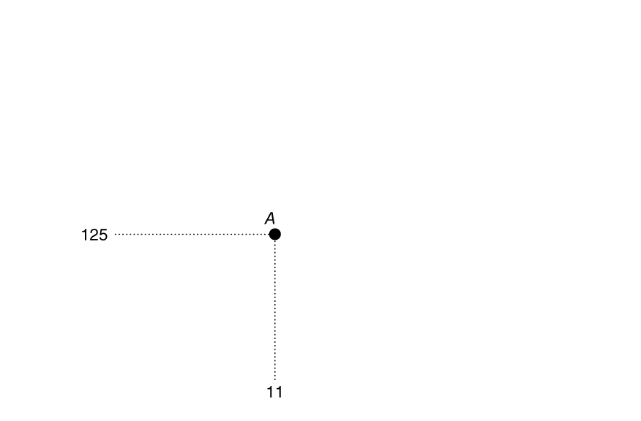
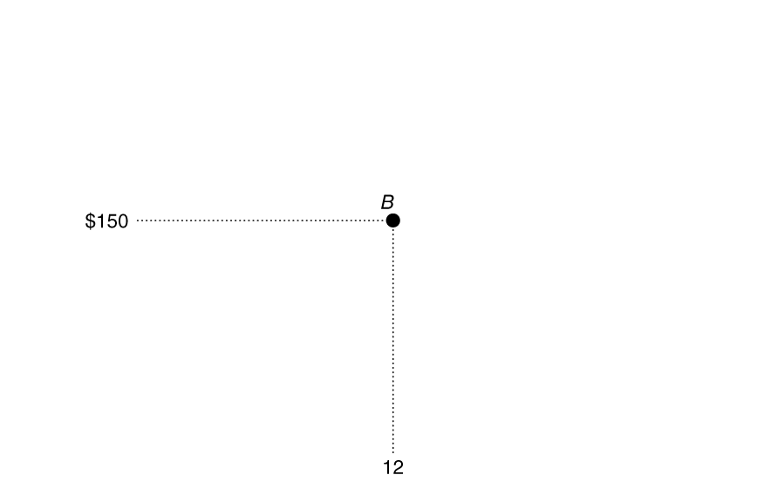
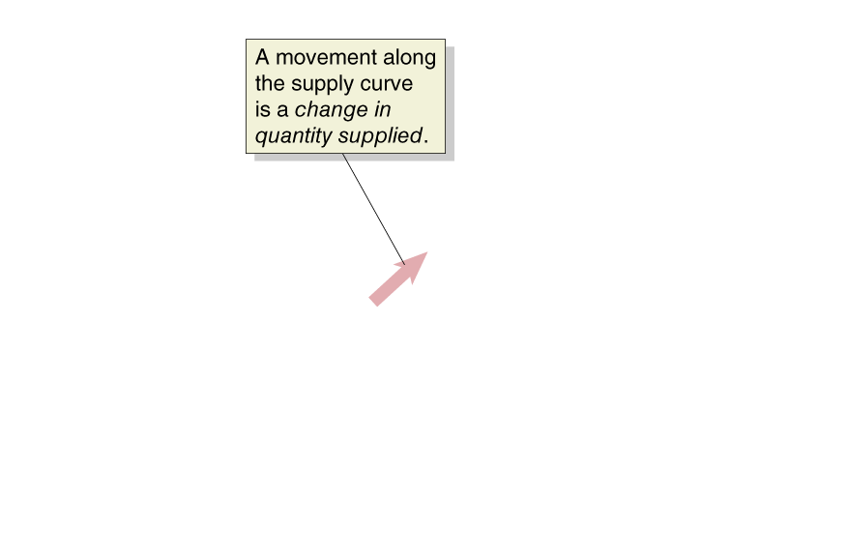
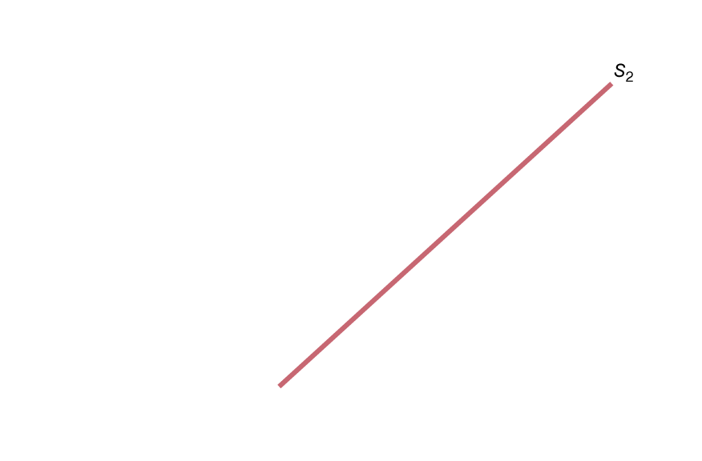
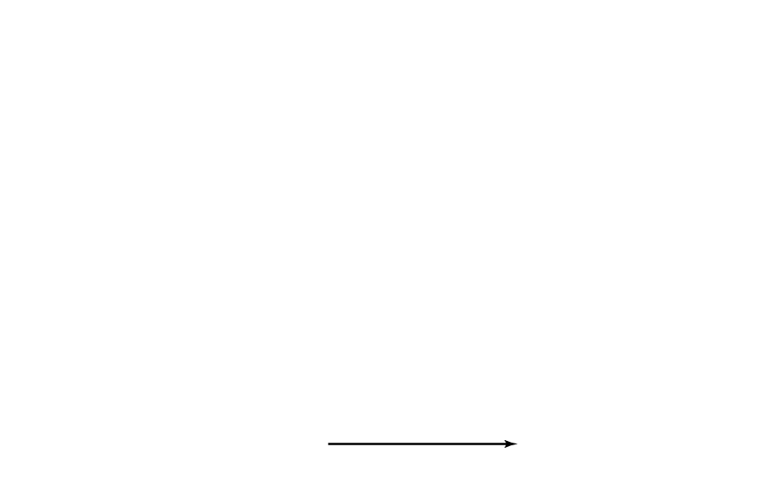
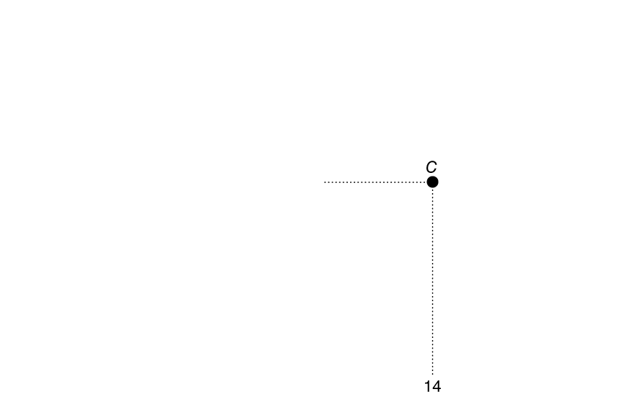
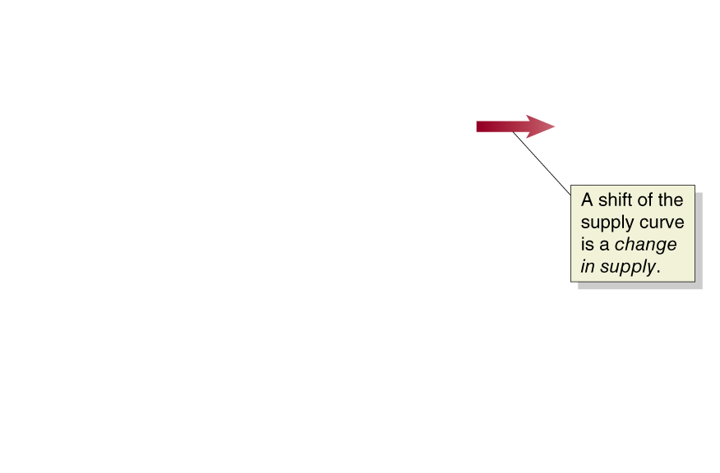
Figure 3.6 A Change in Supply versus a Change in Quantity Supplied
A change in the price of the product being examined causes a movement along the supply curve.
This is a change in quantity supplied.
Any other change affecting supply causes the entire supply curve to shift.
This is a change in supply.

Slide 25
3.3 Market Equilibrium: Putting Demand and Supply Together
Use a graph to illustrate market equilibrium.
Market equilibrium is a situation in which quantity demanded equals quantity supplied.
Recall that markets with many buyers and sellers are perfectly competitive markets; a market equilibrium in one of these markets is called a competitive market equilibrium.
There are ~35 firms selling athletic shoes; we will assume this is enough to generate competitive behavior in the market for athletic shoes.

Slide 26
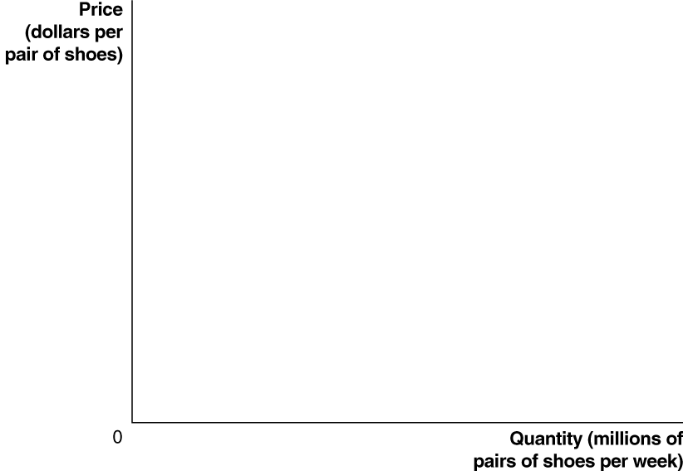





Figure 3.7 Market Equilibrium
At a price of $100,
consumers want to buy 10 million pairs of shoes per week, and
producers want to sell 10 million pairs of shoes per week.
We say the equilibrium price in this market is $100, and the equilibrium quantity is 10 million pairs of shoes per week.
Since buyers and sellers want to trade the same quantity at the price of $100, we do not expect the price to change.

Slide 27






Figure 3.8 The Effect of Surpluses and Shortages on the Market Price (1 of 2)
What if the price were $125 instead?
At a price of $125,
consumers want to buy 9 million pairs of shoes, while
producers want to sell 11 million pairs.
This gives a surplus of 2 million pairs; a situation in which quantity supplied is greater than quantity demanded.
Prediction: sellers will compete amongst themselves, driving the price down.

Slide 28


Figure 3.8 The Effect of Surpluses and Shortages on the Market Price (2 of 2)
Now what if the price were $50?
At a price of $50,
consumers want to buy 12 million pairs of shoes, while
producers want to sell 8 million.
This gives a shortage of 4 million pairs of shoes; a situation in which quantity demanded is greater than quantity supplied.
Prediction: sellers will realize they can increase the price and still sell as many pairs of shoes, so the price will rise.

Slide 29
Table 3.3 How shifts in demand and supply affect equilibrium price (P) and quantity (Q) (2 of 2)
Blank | Supply Curve Unchanged | Supply Curve Shifts to the Right | Supply Curve Shifts to the Left
Demand Curve Unchanged | Q unchanged P unchanged | Q increases P decreases | Q decreases P increases
Demand Curve Shifts to the Right | Q increases P increases | Q increases P increases, decreases, or is unchanged | Q increases, decreases, or is unchanged P increases
Demand Curve Shifts to the Left | Q decreases P decreases | Q increases, decreases, or is unchanged P decreases | Q decreases P increases, decreases, or is unchanged
We can now fill in the rest of Table 3.3.
The cell in red is the example that we just did.

Slide 30
Shifts of a Curve vs. Movements along a Curve
Suppose an increase in supply occurs. We now know:
Equilibrium quantity will increase, and
Equilibrium price will decrease.
It is tempting to believe the decrease in price will cause an increase in demand. But this is incorrect.
The decrease in price will cause a movement along the demand curve but not an increase in demand.
Why? The demand curve already describes how much of the good consumers want to buy, at any given price.
When the price change occurs, we just look at the demand curve to see what happens to how much consumers want to buy.

Slide 31

Copyright

